Slide 1


Slide 2
Problem Statement
Companies find it difficult to manually review every employee record for possible layoff risk.
Late identification affects workforce planning and slows HR decisions.
This project predicts risk early using employee, performance, and context features.

Slide 3
Project Objective
Predict layoff risk as a probability score and a High/Low classification.
Provide a web-based system that HR users can operate without coding knowledge.
Support both single employee analysis and full dataset prediction.

Slide 4
REQUIREMENTS
pandas>=2.0
numpy>=1.24
scikit-learn>=1.3
openpyxl>=3.1
joblib>=1.3
flask>=3.0

Slide 5
Dataset and Features
Training file: Data/processed/Training_Data.csv
Testing file: Data/processed/Testing_Data.csv
Target column: layoff_target
Important features: Age, DistanceFromHome, monthly_income, PerformanceRating, YearsInCurrentRole, department, job_role, overtime, industry_proxy

Slide 6
Algorithm Comparison
Model | Accuracy | ROC-AUC | F1 (Class 1) | Recall (Class 1)
RandomForest | 0.9412 | 0.9340 | 0.4348 | 0.3333
GradientBoosting | 0.9412 | 0.9194 | 0.4348 | 0.3333
AdaBoost | 0.9412 | 0.9006 | 0.4348 | 0.3333
ExtraTrees | 0.9321 | 0.9314 | 0.4828 | 0.4667
LogisticRegression | 0.8416 | 0.9243 | 0.4068 | 0.8000
Selected model in current metadata: RandomForest | Decision threshold: 0.48

Slide 7
Model and Prediction Logic
Saved deployment model: RandomForest
Decision threshold used in app: 0.48
The model generates layoff probability first, then converts it into High or Low risk.

Slide 8
Code Execution Steps
1. Install packages: python -m pip install -r requirements.txt
2. Train model: python scripts\train_compare_models.py
3. Run application: python app.py
4. Open browser: http://127.0.0.1:5000
5. Login and demonstrate dashboard modules one by one

Slide 9
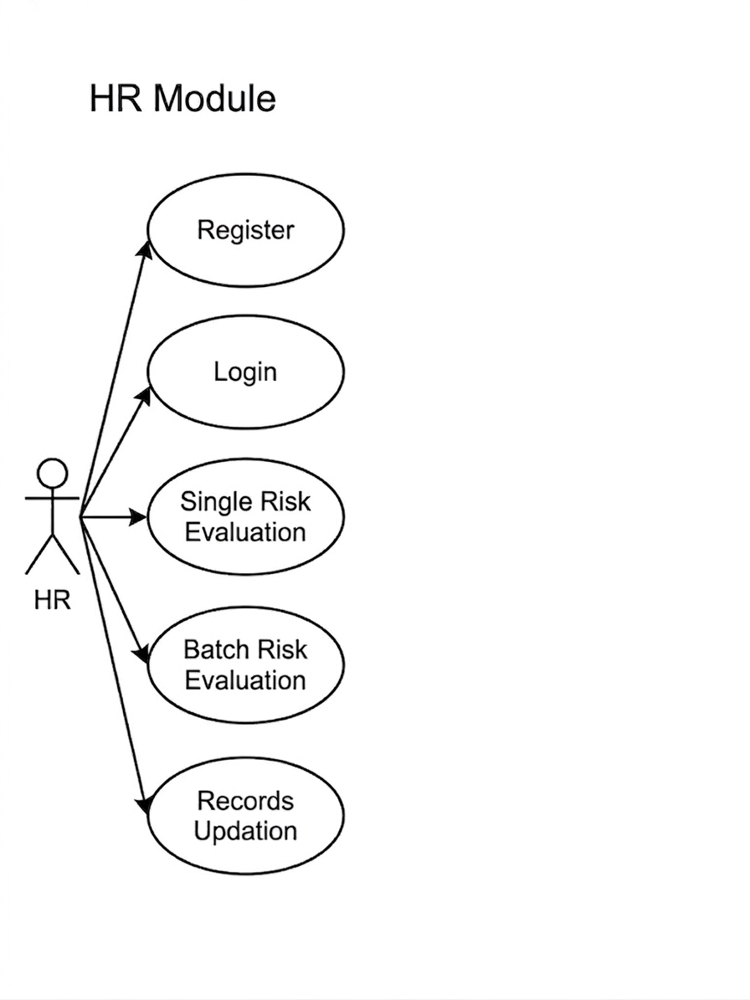

Slide 10
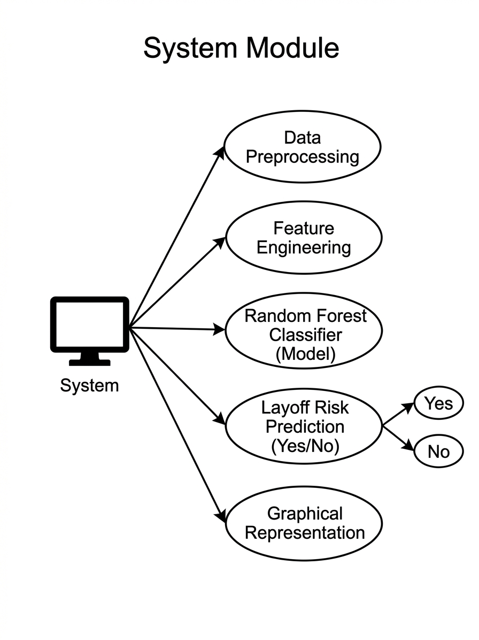

Slide 11
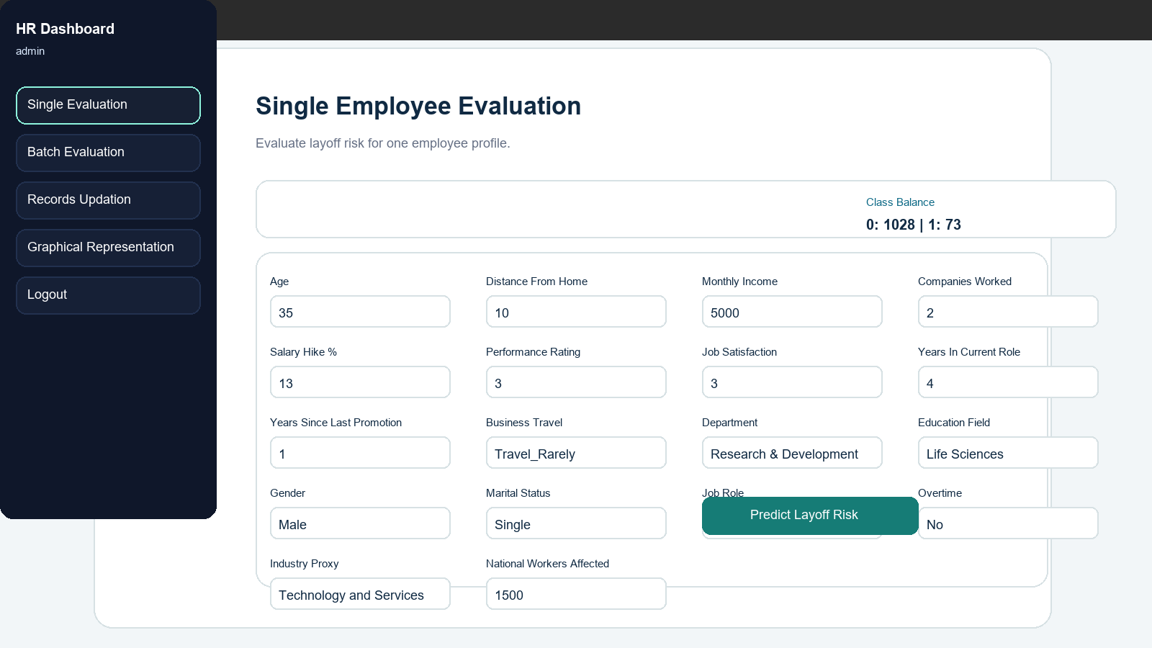
Single Evaluation Screen
Form-based individual employee risk prediction

Slide 12
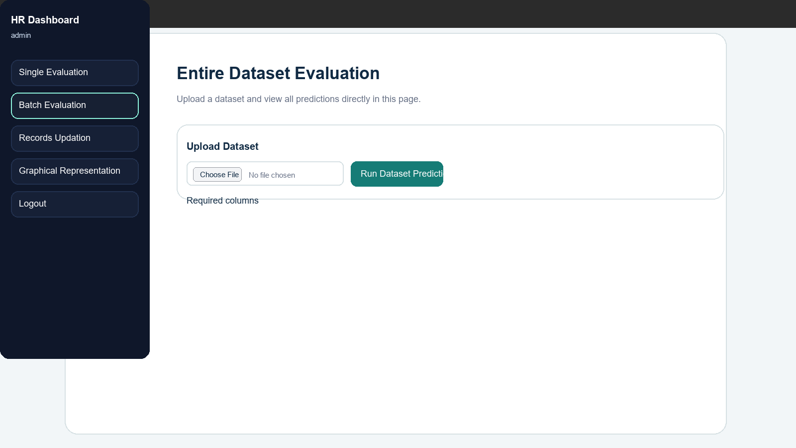
Batch Evaluation Screen
Dataset upload and prediction execution flow

Slide 13
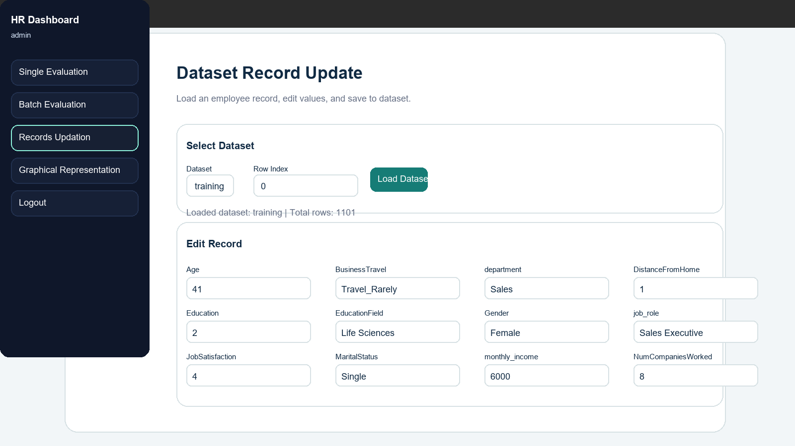
Records Updation Screen
Dataset selection, row loading, and record editing

Slide 14
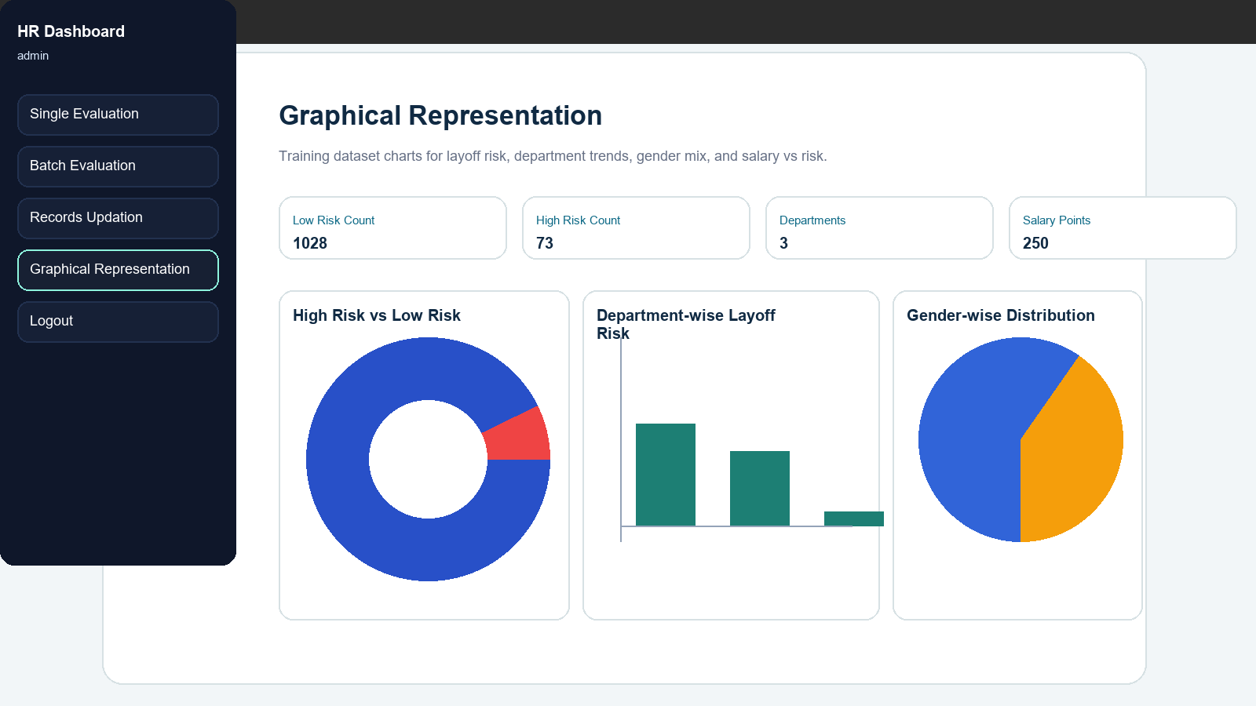
Graphical Representation Screen
Dashboard charts for risk distribution and department patterns

